Slide 1
Hypocrites, dogs, pigs and pearls!

Slide 2
Jesus Christ
More than a teacher
Christ the King
King of Kings
Saviour of the world

Slide 3
“Do not judge….”

Slide 4
“Do not judge, or you too will be judged.”
You are not God!

Slide 5
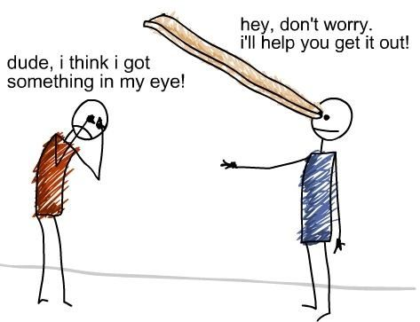

Slide 6
Truths of biblical revelation are holy things….
KINGDOM
SACRED

Slide 8
Don’t throw around indiscriminately
Truths of biblical revelation are holy things….
KINGDOM
SACRED
Thoughtfully
Carefully
Responsibly
Strategically
As part of whole life discernment

